Slide 1
Thermoelectric Concentrator

Slide 2
Group Members
Vinayak Dagade 17ET5505
Kunal Deshmukh 17ET5508
Vedant Gamre 17ET5521
Milind Andhale 17ET5516
Guided By
Mrs.Debajani Mohanta

Slide 3
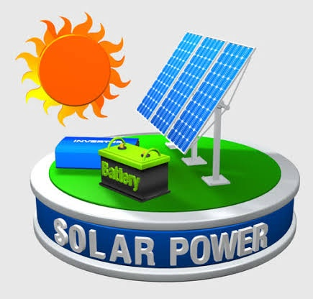
INTRODUCTION
The sun has a surface temperature of 6000°c , maintained by continuous nuclear fusion reactions between hydrogen atoms within its interior.
The sun radiates huge quantities of energy into the surrounding space, and the tiny fraction intercepted by the earth's atmosphere, 150million km away, is how ever equivalent to about 15,000 times humanity's present rate of use of fossil and nuclear fuels.

Slide 4
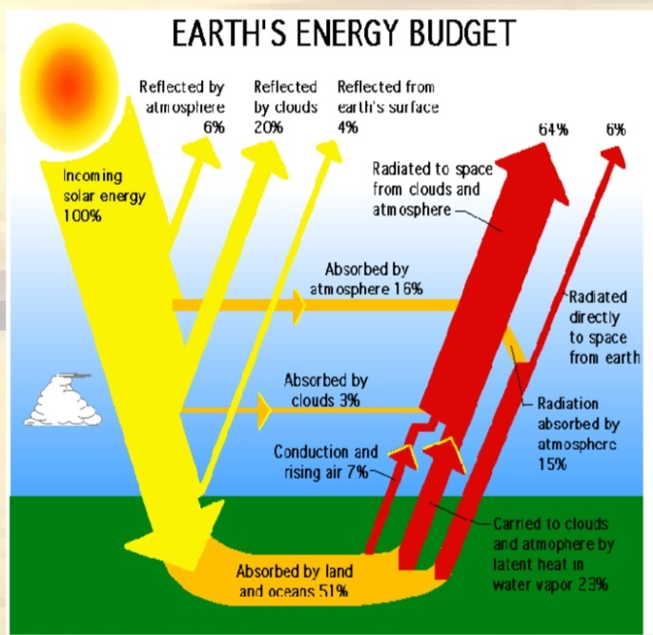
INTRODUCTION
Even though approximately one-third of the intercepted energy is reflected away by the atmosphere before reaching the earth’s surface

Slide 5
SOLAR ENERGY
In the present rapidly developing world, generation and consumption of electrical energy playing an important role without harming the nature of the environment.
Even though a large amount of solar energy is available on the earth surface, only a small portion of it is used for human activities. Presently only a 0.015% of solar energy is used for world electric power production, and 0.3% of solar energy is used for heating of space and water.
To achieve the environment-friendly electrical power generation a lot of research was done.

Slide 6
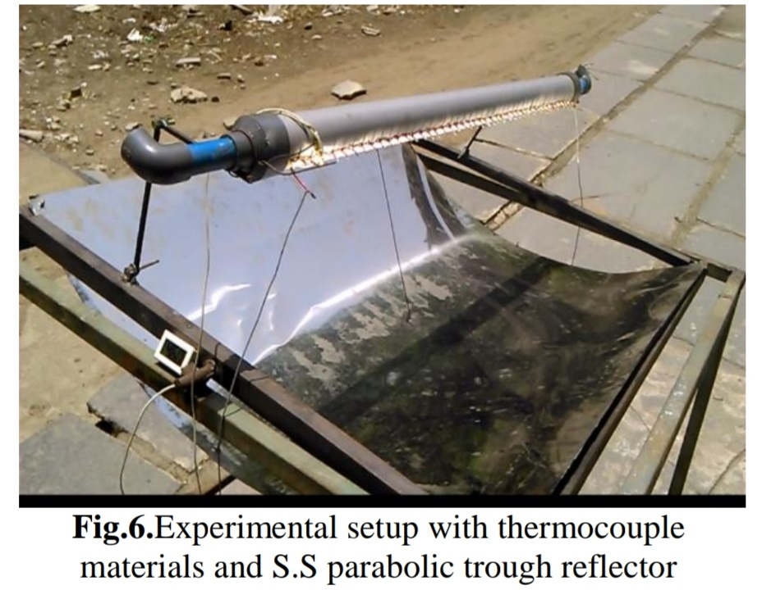
SOLAR ENERGY
A lot of Research is done and still continuing to overcome the difficulties.
In this project a new attempt is made to convert solar energy into electrical energy by using a series of thermocouples and parabolic reflector.

Slide 7
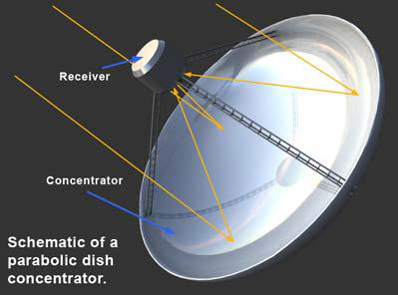
SOLAR CONCENTRATOR
Concentrator: Concentrator are oriented to track the sun so that the beam radiation will be directed on to the absorbing surface. Collector that directs radiation on to the receiver.
Collector: The aperture of the concentrator
is the opening through which the solar
radiation enters the concentrator.
Receiver: Radiation is absorbed and
converted to some other energy
form(e.g.heat).

Slide 8
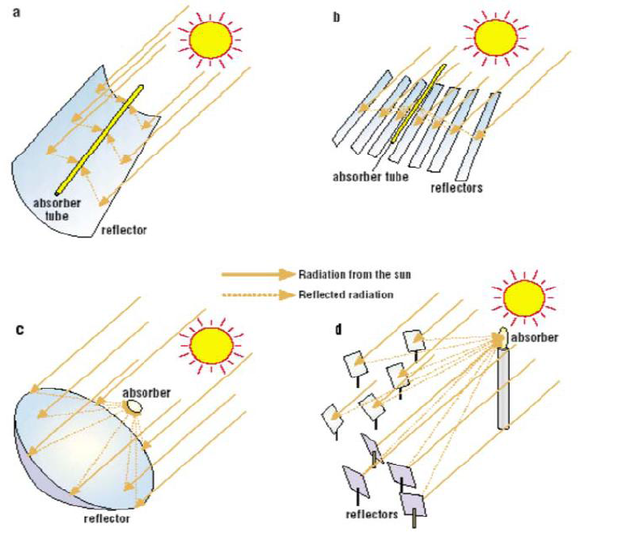
SOLAR CONCENTRATOR
Concentration Types
a)Parabolic collector.
b)Linear Fresnel collector.
c)Central receiver system with
dish collector.
d)Central receiver system with
distributed reflectors.

Slide 9
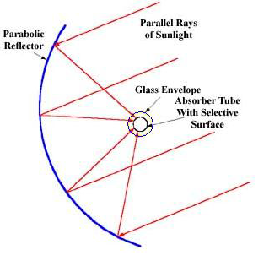
SOLAR CONCENTRATOR
Parabolic Collector
It is a principle of geometry that a parabolic
reflector pointed at the sun will reflect parallel
rays of light to the focal point of the parabola.
A parabolic is a one-dimensional parabola
that focuses solar energy on to a line.
Physically, this line is a pipe with a flowing
liquid inside that absorbs the heat transmitted through the pipe wall and delivers it to the thermal load.

Slide 10
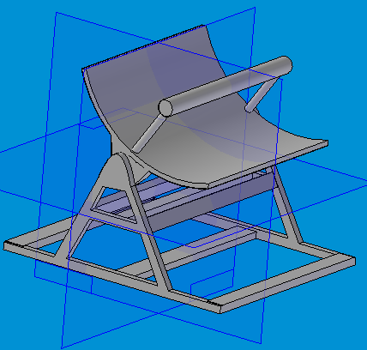
SOLAR CONCENTRATOR
Basic Parts and Structure.
There are basically five major part of a parabolic trough concentrator system, which are as follow:
a) Reflecting surface.
b) Absorber.
c) Tracking system.
d) Pumping system.

Slide 11
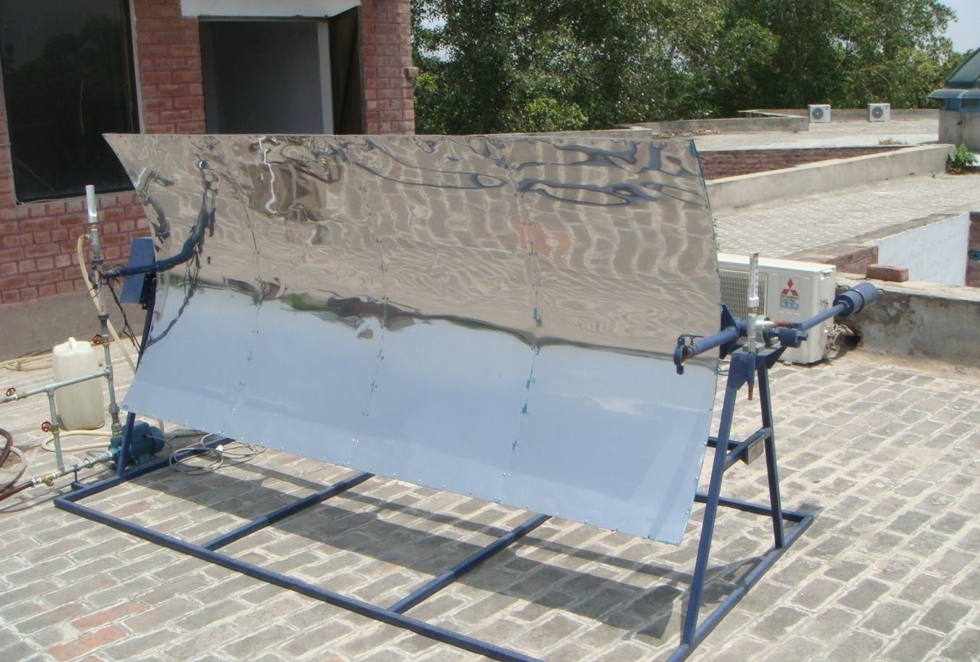
SOLAR CONCENTRATOR
Basic Parts and Structure.
a) Reflecting surface.

Slide 12
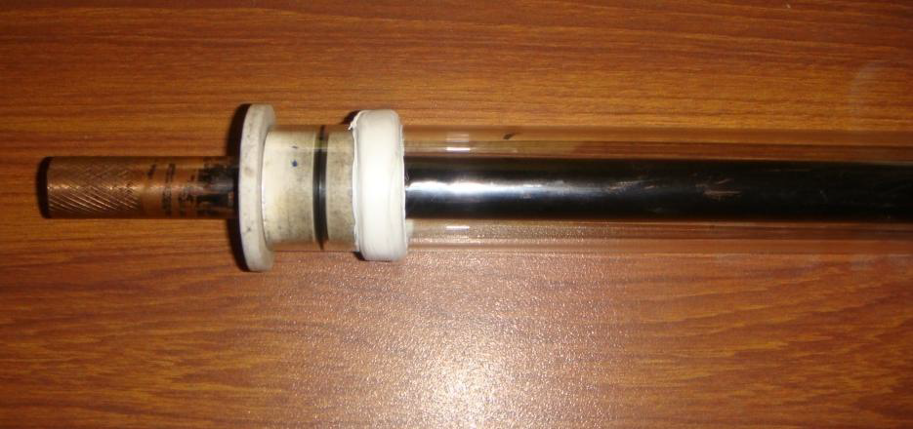
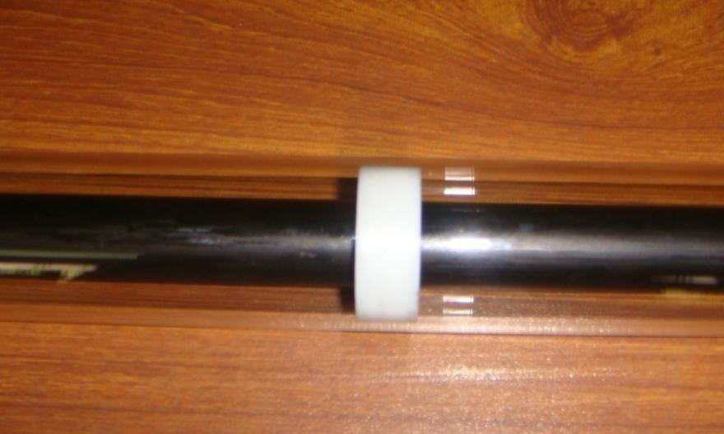
SOLAR CONCENTRATOR
Basic Parts and Structure.
b) Absorber.

Slide 13
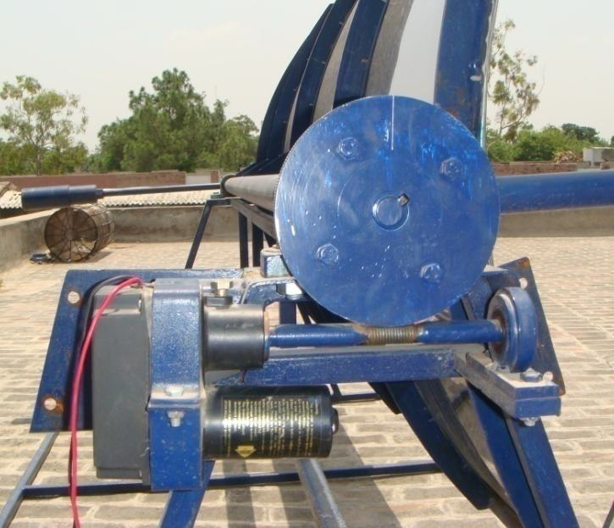
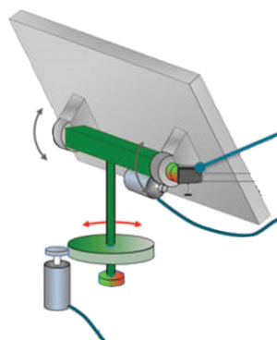
SOLAR CONCENTRATOR
Basic Parts and Structure.
c) Tracking System.

Slide 14
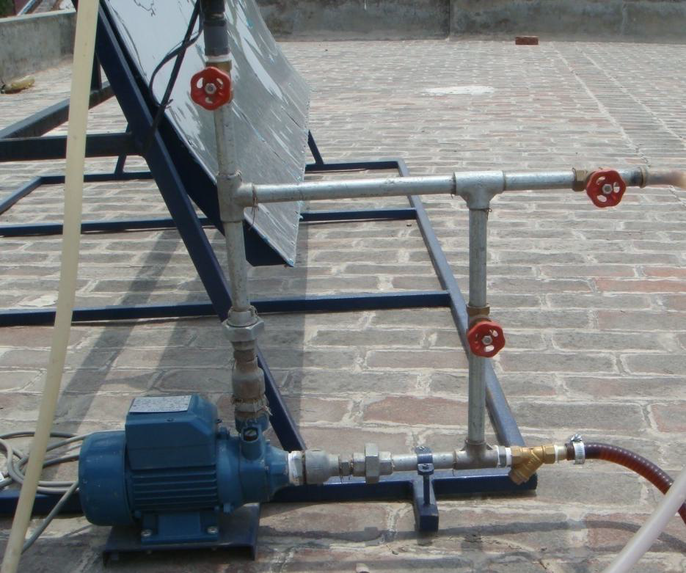
SOLAR CONCENTRATOR
Basic Parts and Structure.
d) Pumping System.

Slide 15
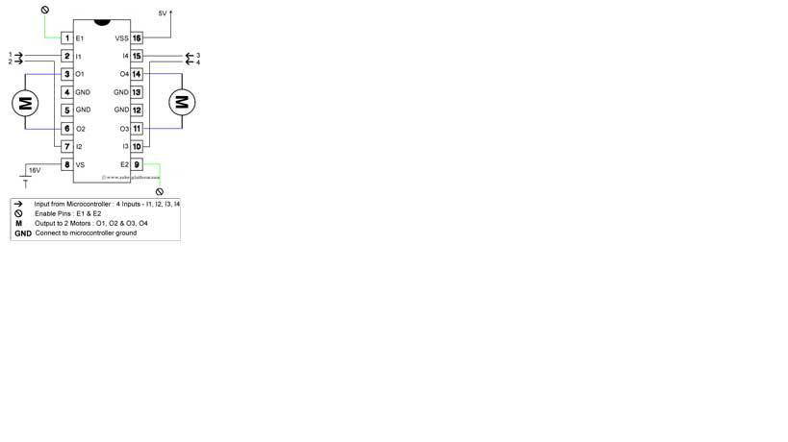
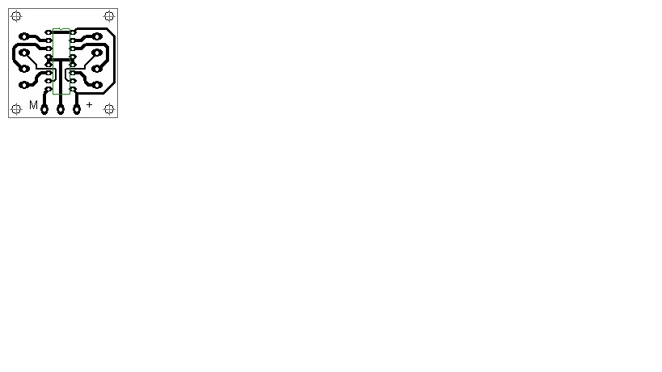
MOTOR DRIVER
Here we use L293D as a motor driver.
It is 16 pin Ic used to control the motor.
We can use two motors using this Ic.
The L293D have 2 Enabled 2 VCC pic.
Enabled 1 can enable the Input Output of 1&2.
Enabled 2 can enable the Input Output of 3&4.

Slide 16
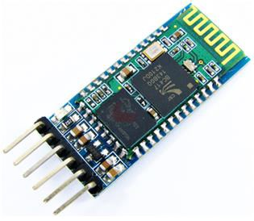
BLUETOOTH
Here we use HC05 Bluetooth Module.
It is a class-2 bluetooth module with Serial Port Profile ,
which can configure as either Master or slave. a Drop-in replacement for wired serial connections, transparent usage.
Bluetooth protocal: Bluetooth Specification v2.0+EDR
Frequency: 2.4GHz ISM band
Modulation: GFSK(Gaussian Frequency Shift Keying)
Speed: Asynchronous: 2.1Mbps(Max) / 160 kbps, Synchronous: 1Mbps/1Mbps
Security: Authentication and encryption
Power supply: +3.3VDC 50mA

Slide 17
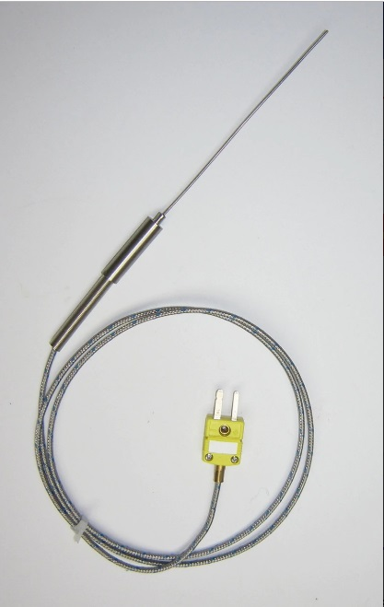
THERMOCOUPLE
A Thermocouple is a device used to convert heat into electrical power. It measures the temperature difference between two points.
Thermocouples is a sensor used to measure temperature. It consist of two wire legs made from different metals. The wires legs are welded together at one end, creating a junction. This junction is where the temperature is measured.
Thermocouples are among the most widely used temperature sensors due to their wide availability and very low cost.

Slide 18

ARDUINO
In this project we are using the Arduino UNO board.
Arduino Uno is a microcontroller board based on the ATmega328P.
It has 14 digital Input/Output pins of which 6 can be used as a PWM outputs.
It has a 16 MHz ceramic resonator (CSTCE16M0V53-R0), a USB connection, a power jack, an ICSP header and a reset button.

Slide 19
ADVANTAGES
It helps in reducing the cost by replacing an expensive large receiver by a less expensive reflecting or refracting area.
Due to concentration on a smaller area, the heat loss area is reduced.
Further the thermal mass as much smaller than that of a flat plate collector and hence transient effects are small.
The delivery temperature being high, a thermodynamic match between the temperature level the task occurs.
It increases the intensity by concentrating the energy available over a large surface onto a smaller surface (absorber).

Slide 20
APPLICATIONS
Solar Concentrating Collector are currently used for.
Cooling and air-conditioning.
Steam generation (for electricity power-plants).
Desalination of sea water.
Production of hot water for domestic and industrial use.
Production of hydrogen gas.

Slide 21
REFERENCE
Sravan Kasireddy Thermoelectric Power Generation By Using Solar Parabolic Trough Reflector.” International Journal of Engineering Research and Applications (IJERA) , vol. 7, no. 11, 2017, pp. 48-54.
International Journal of Engineering Research and Applications (IJERA) is UGC approved Journal with Sl. No. 4525, Journal no. 47088. Indexed in Cross Ref, Index Copernicus (ICV 80.82), NASA, Ads, Researcher Id Thomson Reuters, DOAJ.

Slide 22
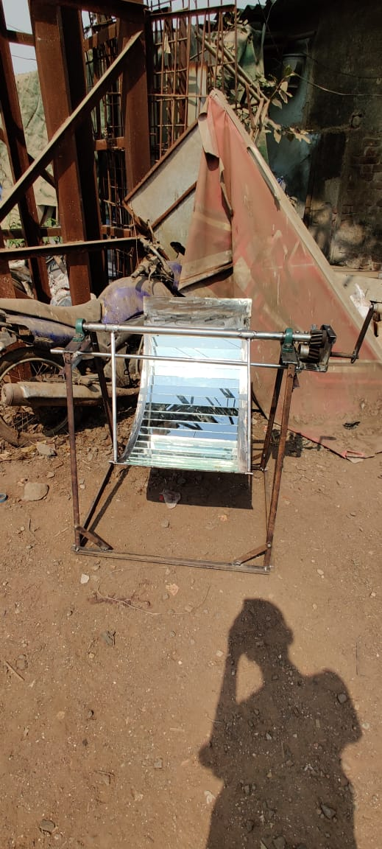
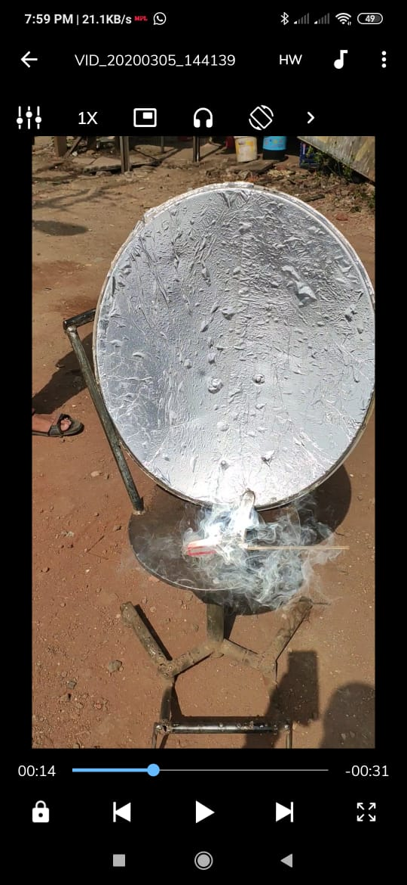
Work Done Till Date

Slide 23
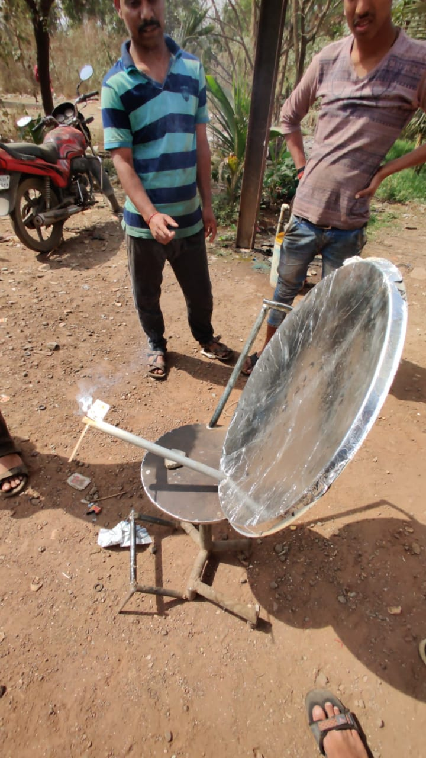
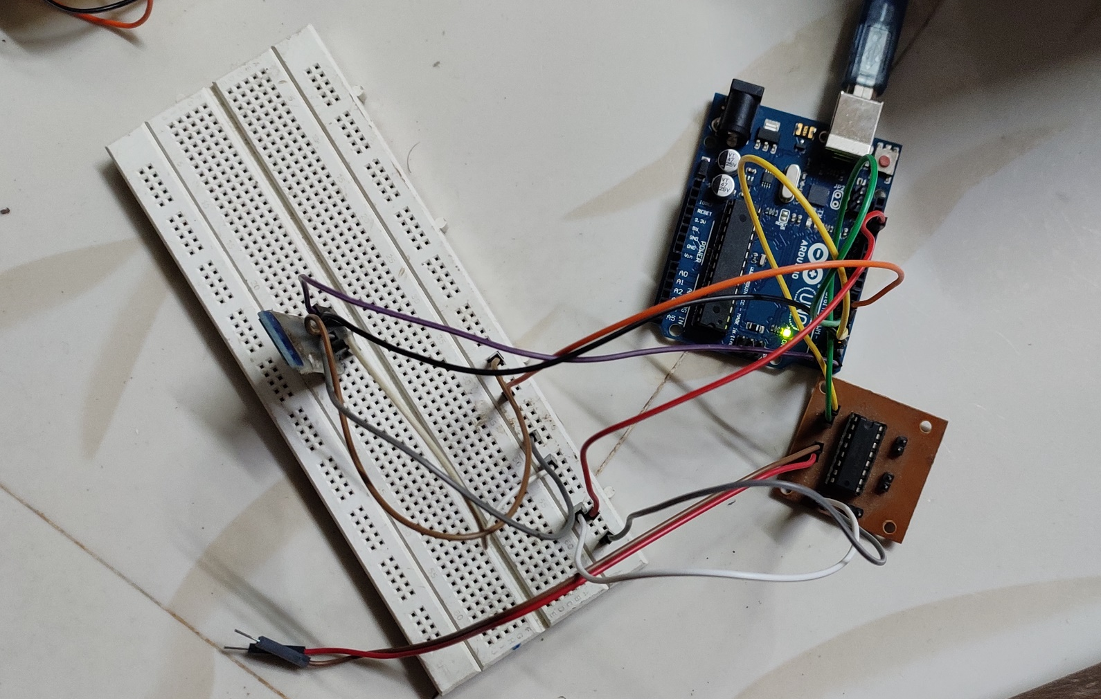

Slide 24
THANK YOU

